Slide 1
Networking Capture the Flag
Networking 2, Day 3

Slide 2

Today, we will be reviewing the past two networking units in a fun competition known as a Capture the Flag (CTF) contest.
2

Slide 3

CTF Instructions and Rules
You’ll be provided a spreadsheet with various networking questions.
These are separated into topics (ports and protocols, packets, pings, etc.)
You will download PCAP files to answer the questions.
The answers to questions will serve as the flags, which you’ll collect and document in your spreadsheet.
Each flag has a different numeric point value. The more challenging the question, the higher the value.
Total points will be calculated automatically in the spreadsheet.
Whoever has the most points by the end of class, or whoever answers all questions correctly first, wins!
3

Slide 4
CTF Spreadsheet
Networking: Capture the Flag Cartoon Edition
Total Score: 0
Category | Question Number | Question/Activity | Flag Value | Flag (all lowercase) | Score
Sponge Bob & Square Ports |  |  |  | Place Flag in This Column
 | 1 | Port of HTTPS | 5 |  | 0
 | 2 |  | 5 |  | 0
 | 3 |  | 5 |  | 0
 | 4 |  | 5 |  | 0
 | 5 |  | 5 |  | 0
 | 6 |  | 5 |  | 0
 | 7 |  | 5 |  | 0
 | 8 |  | 5 |  | 0
 | 9 |  | 10 |  | 0
 | 10 |  | 5 |  | 0
 | 11 |  | 15 |  | 0
Question or activity
Type answer here (lowercase only)
4

Slide 5

CTF Spreadsheet
Networking: Capture the Flag Cartoon Edition
Total Score: 5
Category | Question Number | Question/Activity | Flag Value | Flag (all lowercase) | Score
Sponge Bob & Square Ports |  |  |  | Place Flag in This Column
 | 1 | Port of HTTPS | 5 | 443 | 5
 | 2 |  | 5 |  | 0
 | 3 |  | 5 |  | 0
 | 4 |  | 5 |  | 0
 | 5 |  | 5 |  | 0
Important: All text answers must be typed in lowercase.
5

Slide 6
CTF Rules
You can use your class notes, slides, and online materials.
Flags don’t need to be answered in order.
Instructors and TAs can assist with technical CTF issues, but won’t be helping you to answer any questions.
Good luck! And have fun!
6

Slide 7
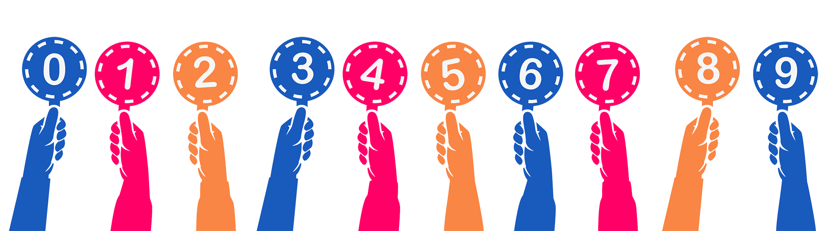
Set up CTF scoring at:
keepthescore.co/new
7
Notes:
Image source: shutterstock_1342667882

Slide 8
Capture the Flag
8

Slide 9


Let’s get started. 2 hours 20 minutes
Click to start timer
9
Notes:
Timer link: https://savvytime.com/timer/2hour20minute

